Slide 1

ICS 3201: Object Oriented Programming
Lecture 1:Review of OO Programming Principles
Instructor: S.C Kiptoo, Computing Department, ICSIT
Email: skiptoo@jkuat.ac.ke

Slide 2
Procedural Programming
Using functions and procedures
Function & program is divided into modules commensurate with main tasks
Every module has its own data and function which can be called by other modules.
Other program modules allowed to modify data independently

Slide 3
Procedural Programming
This programming paradigm is essentially an abstraction of machine /assembly language.
Program is organized around procedures.
Focus on data structures, algorithms and sequencing of steps
Programs = Algorithm + Data Structure
An algorithm is a set of instructions for solving a problem
A data structure is a construct used to organize data in a specific way.
Most computer languages, from early examples like FORTRAN and ALGOL to more recent languages like C and Ada, have been imperative or procedural.

Slide 4
Procedural Programming - Example
Writing a program to handle bank accounts
Customer can open different type of accounts, such as cash account, check account and Loan account.
For each account, customer can deposit, withdraw or transfer.
How is it implemented in HLL such as C or Java?
As a set of procedures/modules acting on a piece of data

Slide 5
Procedural Programming - Example
Programs = Algorithm + Data Structure
Struct account {
char name;
int accountId;
float balance;
float interestYTD;
char accountType;
};
Procedure 1: Deposit() {...}
Data Structure:
Bank Account
Procedure 1: Withdraw() {...}
Procedure 1: Transfer() {...}
A procedural programming language usually consists of :
A collection of variables, each of which at any stage contains a certain value (a number, a character, a string of characters, etc)
A collection of statements that change the values of these variables.
The building-block of this type program is the procedure or function.

Slide 6
Procedural Programming - Disadvantages
Procedures and data are clearly separated.
Missing link in transformation of concepts between analysis & implementation.
Design models are a long step from implementation.
Procedures are often hard to reuse.
Programs are often hard to extend and maintain.

Slide 7
Primitive vs Reference Data Types
byte … Wraps to Byte
int … Wraps to Integer
short … Wraps to Short
long … Wraps to Long
bolean … Wraps to Bolean
double … Wraps to Double
float … Wraps to Float
char … Wraps to Char
Questions: 1. Define typing and show its advantages.
2. Why does java wrap primitive types to objects and what are the advantages of doing so?
3. Why do we say Java is 100% OO yet it processes primitive data types as non objects?

Slide 8
Object-Oriented Programming: OOP
A design and programming technique that bridges the gap between design and coding…How?
Some concepts and terminology:
object - usually a person, place or thing (a noun)
method - an action performed by an object (a verb)
Class aka type - a category of similar objects (such as automobiles)
Objects have both data and methods
Objects of the same class have the same data elements and methods
Objects send and receive messages to invoke actions

Slide 9
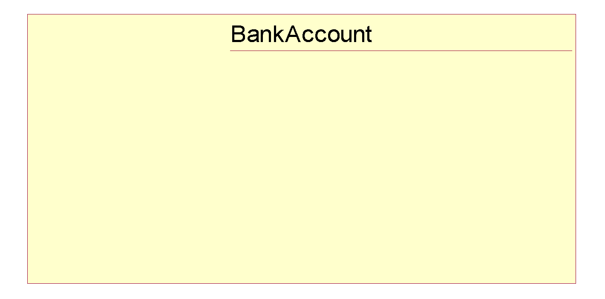
Object-Oriented Programming - Example
The building-block of this type program is class or objects.

Slide 10
What Is Object Technology?
Defined as
A set of principles guiding software construction together with languages, databases, and other tools that support those principles. (Object Technology - A Manager’s Guide, Taylor, 1997)
Notes:
Object technology is not simply the use of an object-oriented language like Java or C++. It is based on the principles of abstraction, modularity, hierarchy, and encapsulation. (These will be defined in Module 3.)
If an organization is to successfully implement object technology, they must use more than a language. They must also use process, a modeling language (UML), data modeling techniques, and so on.

Slide 11
Strengths of Object Technology
A single paradigm
A single language used by users, analysts, designers, and implementers
Bridges the gap between design and implementation
Facilitates architectural and code reuse…..
Models more closely reflect the real world
More accurately describes corporate entities
Decomposed based on natural partitioning
Easier to understand and maintain
Stability
A small change in requirements does not mean massive changes in the system under development
Adaptive to change
Notes:
An object-oriented model aims at reflecting the world we experience in reality. Thus, the objects themselves often correspond to phenomena in the real world that the system is to handle. For example, an object can be an invoice in a business system or an employee in a payroll system.
Object technology can help a company change its systems almost as fast as the company itself changes.

Slide 12
Basic concepts of OO

Slide 13
Basic Concepts of Object Orientation
Object
Class
Message
Basic Principles of Object Orientation
Abstraction
Encapsulation
Inheritance
Polymorphism
Interface and Abstract Class

Slide 14

What Is an Object?
Informally, an object represents an entity, either physical, conceptual, or software.
Physical entity
Conceptual entity
Software entity
Truck
Chemical Process
Linked List
Notes:
Objects allow the software developer to represent real-world concepts in their software design. These real-world concepts can represent a physical entity such as a person, truck, or space shuttle.
Objects can be concepts like a chemical process or algorithms.
Object can even represent software entities like a linked list.

Slide 15
Example
Real-world objects have attributes and behaviors.
Examples:
Dog
Attributes: breed, color, hungry, tired, etc.
Behaviors: eating, sleeping, etc.
Bank Account
Attributes: account number, owner, balance
Behaviors: withdraw, deposit

Slide 16
Software Objects
Writing software often involves creating a computational model of real-world objects and processes.
Object-oriented programming is a methodology that gives programmers tools to make this modeling process easier.
Software objects, like real-world objects, have attributes and behaviors.
Your best bet is to think in terms as close as possible to the real world

Slide 17

A More Formal Definition
An object is an entity with a well-defined boundary and identity that encapsulates state and behavior.
State is represented by attributes and relationships.
Behavior is represented by operations, methods, and state machines.
Attributes
Object
Operations
Notes:
An object is an entity that has a well-defined boundary. That is, the purpose of the object should be clear.
An object has two key components: attributes and operations.
Attributes represent an object’s state, and operations represent the behavior of the object.
Object behavior and state are discussed in the next few slides.
Take a moment to explain the graphic on this slide.
Attributes are documented on the inside of the doughnut.
Operations are documented on the borders, which will become clear to the student as we discuss topics like encapsulation.
Note that the doughnut is not part of the UML notation. UML notation will be discussed later.

Slide 18
An Object Has State
The state of an object is one of the possible conditions in which an object may exist.
The state of an object normally changes over time.
Name: J Clark
Employee ID: 567138
HireDate: 07/25/1991
Status: Tenured
Discipline: Finance
MaxLoad: 3
Professor Clark
Name: J Clark
Employee ID: 567138
Date Hired: July 25, 1991
Status: Tenured
Discipline: Finance
Maximum Course Load: 3 classes
Professor Clark
Notes:
The state of an object is one of the possible conditions that an object may exist in, and it normally changes over time.
The state of an object is usually implemented by a set of properties called attributes, along with the values of the properties and the links the object may have with other objects.
State is not defined by a “state” attribute or set of attributes. Instead, state is defined by the total of an object’s attributes and links. For example, if Professor Clark’s status changed from Tenured to Retired, the state of the Professor Clark object will change.
Provide some supplemental state exercises to ensure that the class understands the concept of state.

Slide 19
An Object Has Behavior
Behavior determines how an object acts and reacts.
The visible behavior of an object is modeled by the set of messages it can respond to (operations the object can perform).
SubmitFinalGrades()
AcceptCourseOffering()
Professor Clark
Professor Clark’s behavior
Submit Final Grades
Accept Course Offering
Take Sabbatical
Maximum Course Load: 3 classes
SetMaxLoad()
TakeSabbatical()
Professor Clark
Notes:
The second characteristic of an object is that it has behavior. Objects are intended to mirror the concepts that they are modeled after, including behavior.
Behavior determines how an object acts and reacts to requests from other objects.
Object behavior is represented by the operations that the object can perform. For example, Professor Clark can choose to take a sabbatical once every five years. The Professor Clark object represents this behavior through the TakeSabbatical() operation.

Slide 20


An Object Has Identity
Each object has a unique identity, even if the state is identical to that of another object.
Professor “J Clark” teaches Biology
Professor “J Clark” teaches Biology
Notes:
In the real world, two people can share the same characteristics: name, birth date, job description. Yet, there is no doubt that they are two individuals with a unique identity.
The same concept holds true for objects. Although two objects may share the same state (attributes and relationships), they are separate, independent objects with their own unique identity.

Slide 21
Objects Need to Collaborate
Objects are useless unless they can collaborate together to solve a problem.
Each object is responsible for its own behavior and status.
No one object can carry out every responsibility on its own.
How do objects interact with each other?
They interact through messages.
Notes:
At this stage, we’ve discovered a number of different classes and defined these classes. However, our work has just begun. These objects need to realize the behavior specified in each use-case scenario. How is this done? The objects must collaborate together to bring about the desired behavior in the system.
Is there a mechanism that will allow these objects to work together? There is, and that mechanism is called a message.
We are working our way toward CRC cards. The goal of this slide is to make students aware that collaborations are a key part of a successful OO solution.

Slide 22
Software Objects - Cont’d
In traditional programming languages (Fortran, Cobol, C, etc)
data structures and procedures are defined separately.
In object-oriented languages, they are defined together.
An object is a collection of attributes and the behaviors that operate on them.
Variables in an object are called attributes.
Procedures associated with an object are called methods.
Bank
Account
Account
Account
number:
balance:
deposit()
withdraw()

Slide 23
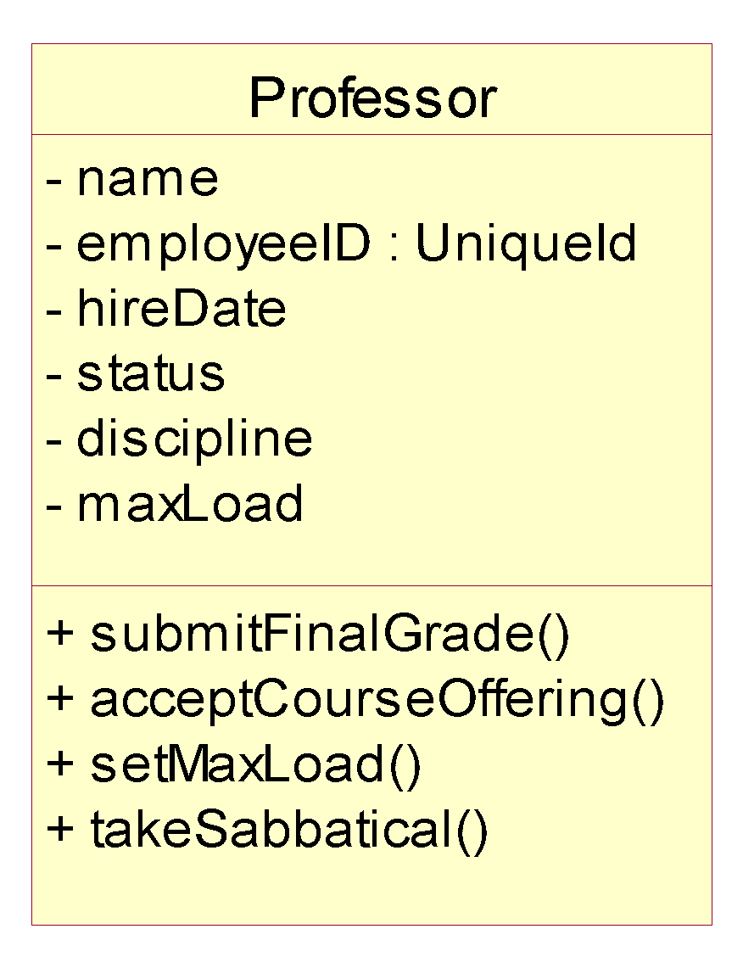
What Is a Class?
A class is a description of a set of objects that share the same properties and behavior.
An object is an instance of a class.
Class: Professor
Objects
Attributes
Professor Smith
Professor Mellon
Professor Jones
Operations
Notes:
A Class can be defined as:
A description of a set of objects that share the same attributes, operations, relationships, and semantics. (The Unified Modeling Language User Guide, Booch, 1999)
There are many objects identified for any domain.
Recognizing the commonalties among the objects and defining classes helps us deal with the potential complexity.
The OO principle abstraction helps us deal with complexity.

Slide 24
Classes
The definitions of the attributes and methods of an object are
organized into a class. Thus, a class is the generic definition
for a set of similar objects (i.e. Person as a generic definition
for say Jane, Paul and Susan)
A class can be thought of as a template used to create a set of objects.
A class is a static definition; a piece of code written in a programming language.
One or more objects described by the class are instantiated at runtime.
The objects are called instances of the class.

Slide 25
Classes - Cont’d
Each instance will have its own distinct set of attributes.
Every instance of the same class will have the same set of attributes;
every object has the same attributes but,
each instance will have its own distinct values for those attributes.
Notes:
Note: There are other terms that are synonymous with state variables: fields and data members. There are additional terms that represent similar ideas, but have subtle differences: such as variables (includes locals, parameters and automatic vars, and all state variables), instance variables (or instance fields, or instance members) which represent a subset of the state variables, and class variables (or class fields, or class members) which represent a difference subset of the state variables. These subsets will be explored in later sections of this course.

Slide 26
Bank Example
The "account" class describes the attributes and behaviors of bank accounts.
The “account” class defines two state variables (account number and balance) and two methods (deposit and withdraw).
class: Account
number:
balance:
deposit()
withdraw()

Slide 27
Bank Example - Cont’d
When the program runs there will be many instances of the account class.
Each instance will have its own account number and balance (object state)
Methods can only be invoked .
Instance #1
number: 054
balance: $19
Instance #2
number: 712
balance: $240
Instance #3
number: 036
balance: $941

Slide 28
Encapsulation
When classes are defined, programmers can specify that
certain methods or state variables remain hidden inside the
class.
These variables and methods are accessible from within the class, but not accessible outside it.
The combination of collecting all the attributes of an object into a single class definition, combined with the ability to hide some definitions and type information within the class, is known as encapsulation.
Visible Methods
Hidden State Variables and Methods
Visible Variables
Class Definition
Notes:
OOP encapsulation is roughly analogous to only allowing a user to access data in a database via predefined stored procedures.
Users can access the data, but not directly and without having to have direct knowledge of its structure.

Slide 29
Graphical Model of an Object
Instance variables
balance()
withdraw()
theBalance
deposit()
acctNumber
Methods
accountNumber()
State variables make up the nucleus of the object. Methods surround and hide (encapsulate) the state variables from the rest of the program.

Slide 30
Instance Methods and Instance Variables
The methods and variables described in this module so far are known as instance methods and instance variables.
These state variables are associated with the one instance of a class; the values of the state variables may vary from instance to instance.
Instance variables and instance methods can be public or private.
It is necessary to instantiate (create an instance of) a class to use it’s instance variables and instance methods.
Notes:
Note: Class variables and methods are declared with the static keyword in Java.

Slide 31
Class Methods and Class Variables
In addition to instance methods and instance variables, classes
can also define class methods and class variables.
These are attributes and behaviors associated with the class as a whole, not any one instance.
Class variables and class methods can be public or private.
It is not necessary to instantiate a class to use it’s class variables and class methods.
Notes:
Note: Class variables and methods are declared with the static keyword in Java.

Slide 32
Class Variables
A class variable defines an attribute of an entire class.In contrast, an instance variable defines an attribute of a single instance of a class.
instance variables
Account
class variable
count: 3
printCount()
num: 054 bal: $19
num: 712 bal: $240
num: 036 bal: $941
Class method

Slide 33
A Sample Class
Class: Automobile
Data Items:
manufacturer’s name
model name
year made
color
number of doors
size of engine
etc.
Methods:
Define data items (specify manufacturer’s name, model, year, etc.)
Change a data item (color, engine, etc.)
Display data items
Calculate cost
etc.

Slide 34
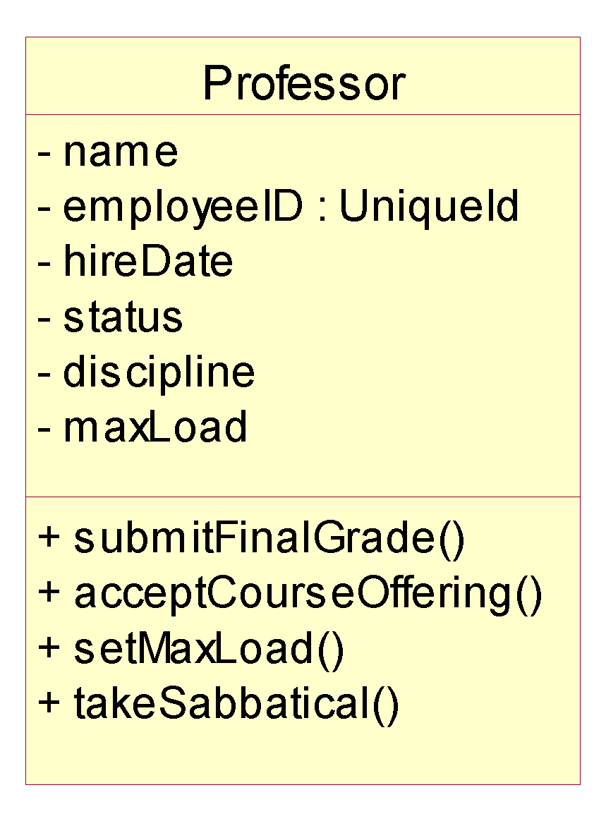
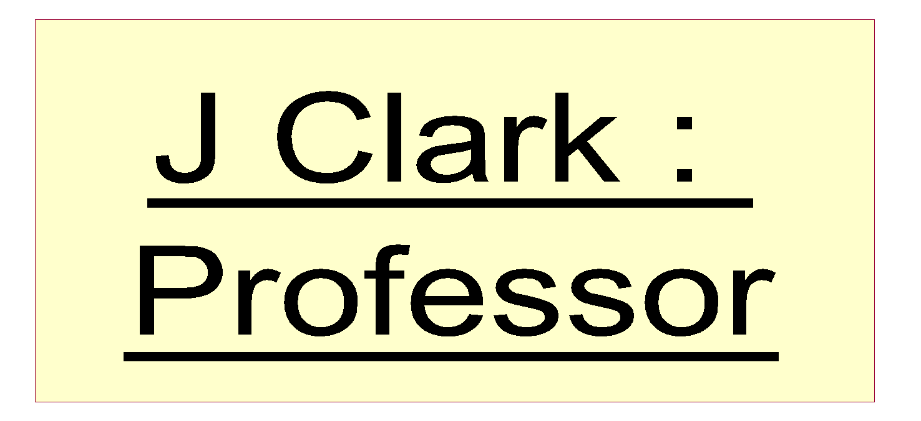
The Relationship Between Classes and Objects
A class is an abstract definition of an object.
It defines the structure and behavior of each object in the class.
It serves as a template for creating objects
Objects are grouped into classes.
An object is an instance of a class.
From Real World
Class: Professor
Professor Jones
Professor Smith
abstracting
Objects
Professor Mellon
instancing
Objects
To computer World
Notes:
A class is a description of a set of objects that share the same responsibilities, relationships, operations, attributes, and semantics.
An object is defined by a class. A class defines a template for the structure and behavior of all its objects. The objects created from a class are also called the instances of the class.
The class is the static description, and the object is a run-time instance of that class.
We model from real-world objects. Software objects are based on the real-world objects, but exist only in the context of the system.
We use real-world objects, abstract out what you don't care about. Then, take these abstractions and go through the process of classification based on what you do care about. Classes in the model are the result of this classification process.
These classes are then used as templates within an executing software system to create software objects. These software objects represent the real-world objects we originally started with.
Some classes/objects may be defined that don't represent real-world objects. They are there to support the design and are "software only.”
A class is to an object what a cookie cutter is to a cookie.

Slide 35
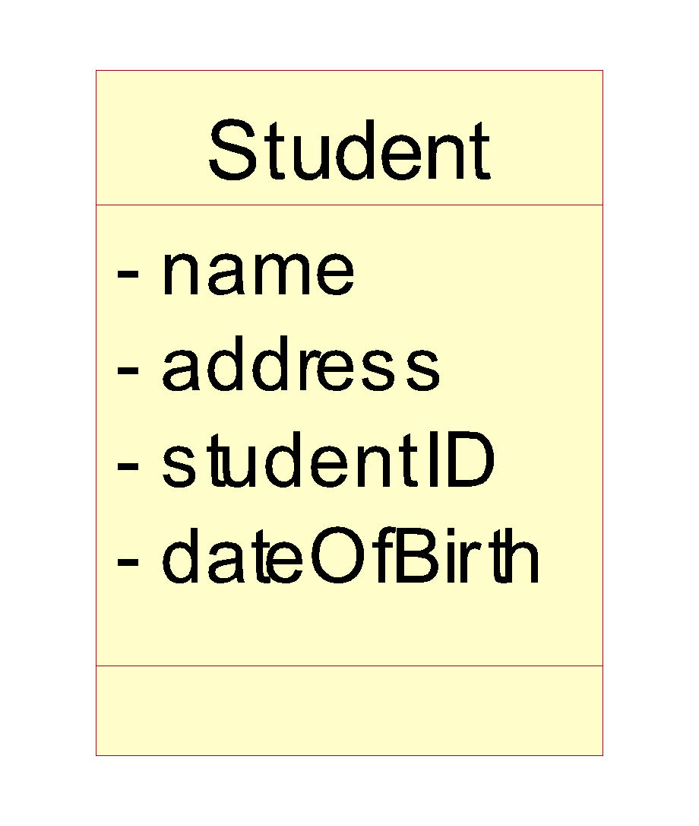
What Is an Attribute?
An attribute is a named property of a class that describes a range of values instances of the property may hold.
A class may have any number of attributes or no attributes at all.
Attributes
Notes:
An attribute can be defined as:
A named property of a class that describes the range of values that instances of the property may hold. (The Unified Modeling Language User Guide, Booch, 1999)
A class may have any number of attributes or no attributes at all. At any time, an object of a class will have specific values for every one of its class’s attributes.
An attribute defined by a class represents a named property of the class or its objects. An attribute has a type that defines the type of its instances.
An attribute has a type, which tells us what kind of attribute it is. Typical attributes are integer, Boolean, real, and enumeration. These are called primitive types. Primitive types can be specific for a certain programming language.
Remember, there are still operations in this class, but we chose to suppress them.

Slide 36
Attributes in Classes and Objects
Class
name: M. Modano
address: 123 Main
studentID: 9
dateofBirth: 03/10/1967
Objects
name: D. Hatcher
address: 456 Oak
studentID: 2
dateofBirth: 12/11/1969
Notes:
At the class level, the Student class attributes indicate that the Students have names, addresses, studentID’s, and a date of birth.
At the object level, the attributes indicate the values for the name, address, studentID, and date of birth.
Only the class instance (objects) should be able to change the value of the attributes.
The state of an object is defined by the value of its attributes and the existence of links to other objects.
Remember, the doughnuts are not UML icons. They are included in this illustration to show that the attribute values are set in the individual object.
Object diagrams do not permit you to view the attribute values.

Slide 37
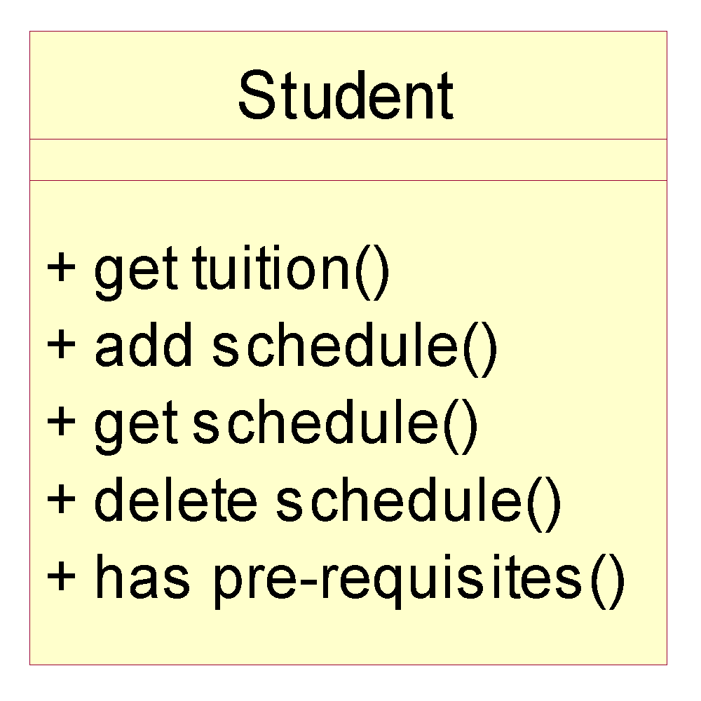
What Is an Operation?
An operation is the implementation of a service that can be requested from any object of the class to affect behavior.
A class may have any number of operations or none at all.
Operations
Notes:
An operation can be defined as:
The implementation of a service that can be requested from any object of the class to affect behavior. (The Unified Modeling Language User Guide, Booch, 1999)
The operations in a class describe what the class can do.
An operation can either be a command or a question. A question should never change the state of the object. Only a command can change the state of the object.
An operation is described with a return-type, name, and zero or more parameters. Together, the return-type, name, and parameters are called the signature of the operation.
The outcome of the operation depends on the current state of the object. Often, but not always, invoking an operation on an object changes the object’s data or state.
Point out that these should be called operations. Many people will use the term methods instead of operations.
In the UML, methods and operations are not synonymous and have distinct definitions.

Slide 38
Example: class Professor
class Professor {
private String name;
private int age;
private String speciality;
public Professor (String sm, int ia, String ss) {
name = sm;
age = ia;
speciality = sst;
}
public String getName () { return name;}
public int getAge () { return age;}
public String getSpeciality () { return speciality;}
}
Professor
- name : String
- age : int
- speciality : String
+getName() : String
+getAge() : int
+getSpeciality() : String

Slide 39
Example : Instance of Professor
wang : Professor
name = “wang”
age = 35
speciality = “computer”
Professor wang = new Professor (“wang”, 35, “computer”);

Slide 40
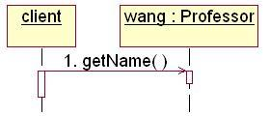
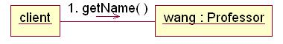
What is a message?
A specification of a communication between objects that conveys information with the expectation that activity will ensue
One object asks another object to perform an operation.
What is your name?
Professor wang
wang.getName()

Slide 41
Example: Object Interaction
The OrderEntryForm wants Order to calculate the total dollar value for the order.
calculateOrderTotal()
CalculateOrderTotal()
orderID
date
salesTotal
tax
shipDate
Message
OrderEntryForm
Order
The class Order has the responsibility to calculate the total dollar value.
Notes:
This example demonstrates how objects interact to achieve the desired business functionality. The example is from an order-entry system where the order-entry clerk enters all sales information on the OrderEntryForm, stereotyped as a boundary class.
After all information has been entered into the form, the system must calculate the total dollar value for the sale. Calculating the total dollar value for the sale involves knowledge of the list price of the items in the sale, tax, and any discounts that may apply.
It does not make sense for the OrderEntryForm to calculate the total dollar amount because it does not own the attribute that stores this value. The object that owns this attribute is the Order object. Therefore, the Order object has an operation, calculateOrderTotal, that knows how to calculate the sales total. Also, in keeping with the principle of encapsulation, no other object should be allowed to change the value of sales total.
The OrderEntryForm knows that the sales total needs to be calculated. Therefore, it sends a message to Order to carry out this behavior. The Order object will calculate the total and send a return value back to the OrderEntryForm where the total can be displayed.
Point out how messages support the principle of encapsulation.
As a rule of thumb, if an attribute is owned by an object, that object needs to know how to calculate the values for that attribute. No other object should be able to do so.
Remember, class responsibilities are realized by its operations and attributes.

Slide 42
Basic Principles of Object Orientation
Object Orientation
Abstraction
Encapsulation
Inheritance
Polymorphism
Notes:
There are four basic principles of object orientation. They are:
Abstraction
Encapsulation
Inheritance
Polymorphism
Be sure the students understand objects before you begin this next section.
We’ve introduced objects first to help students better apply each of these principles.

Slide 43

What Is Abstraction?
Abstraction can be defined as:
Any model that includes the most important, essential, or distinguishing aspects of something while suppressing or ignoring less important, immaterial, or diversionary details. The result of removing distinctions so as to emphasize commonalties. (Dictionary of Object Technology, Firesmith, Eykholt, 1995)
Abstraction
Emphasizes relevant characteristics.
Suppresses other characteristics.
BriefCase
- Capacity
- Weight
+ open()
+ close()
Notes:
Abstraction can be defined as:
Any model that includes the most important, essential, or distinguishing aspects of something while suppressing or ignoring less important, immaterial, or diversionary details. The result of removing distinctions so as to emphasize commonalties. (Dictionary of Object Technology, Firesmith, Eykholt, 1995)
Abstraction allows us to manage complexity by concentrating on the essential characteristics of an entity that distinguish it from all other kind of entities.
An abstraction is domain and perspective dependent. That is, what is important in one context, may not be in another.
OO allows us to model our system using abstractions from the problem domain (for example, classes and objects).
A car is an example of an abstraction. A car is an abstraction for “a mobile, powered vehicle for transporting people from place to place.”
The abstract use of car is not concrete. However, if you describe the car as a 1995 Blue Ford Mustang, then it becomes a concrete manifestation and not an abstraction.
Discuss the makings of a good abstraction.
Concise
Single coherent concept, and so on

Slide 44


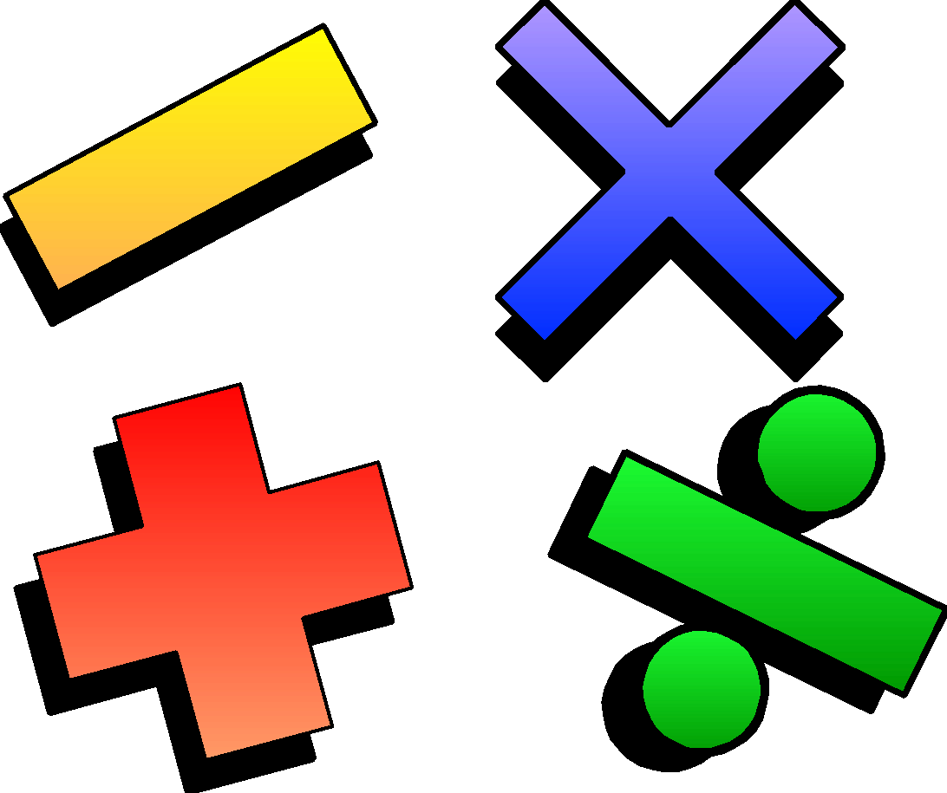

Example: Abstraction
Student
Professor
Course Offering (9:00 AM,
Monday-Wednesday-Friday)
Course (e.g. Algebra)
Notes:
The following are examples of abstraction.
A student is a person enrolled in classes in the university.
A professor is a person teaching classes at the university.
A course is a class offered by the university.
A course offering is a specific offering for a course, including days of the week and times.

Slide 45
What Is Encapsulation?
Encapsulation means to design, produce, and describe software so that it can be easily used without knowing the details of how it works.
Also known as information hiding
An analogy:
When you drive a car, you don’t have know the details of how many cylinders the engine has or how the gasoline and air are mixed and ignited.
Instead you only have to know how to use the controls.

Slide 46
What Is Encapsulation?
Hide implementation from clients
clients depend on interface
Improves Resiliency
Notes:
Encapsulation can be defined as:
The physical localization of features (e.g., properties, behaviors) into a single blackbox abstraction that hides their implementation (and associated design decisions) behind a public interface. (Dictionary of Object Technology, Firesmith, Eykholt, 1995)
Encapsulation is often referred to as “information hiding,” making it possible for the clients to operate without knowing how the implementation implements the interface.
Encapsulation eliminates direct dependencies on the implementation (clients depend on/use the interface). Thus, it’s possible to change the implementation without updating the clients as long as the interface is unchanged.
Clients will not be affected by changes in implementation, thus reducing the “ripple effect,” where a correction to one operation forces the corresponding correction in a client operation and so on. As a result of encapsulation, maintenance is easier and less expensive.
Encapsulation offers two kinds of protection. It protects an object’s internal state from being corrupted by its clients and client code from changes in the object’s implementation.
Encapsulation is putting the “data bits” and operations that manipulate them in the same place.
Encapsulation does NOT allow direct manipulation of things that have been encapsulated without using the supplied interface.
An example is a car’s accelerator. Generally speaking, you put your foot down and the car goes faster. You don’t worry about the cables, electronics, engine, and the rest.

Slide 47
Encapsulation Illustrated
Professor Clark needs to be able to teach four classes in the next semester.
Professor Clark
SubmitFinalGrades()
AcceptCourseOffering()
Name: J Clark
Employee ID: 567138
HireDate: 07/25/1991
Status: Tenured
Discipline: Finance
MaxLoad:4
SetMaxLoad(4)
SetMaxLoad()
TakeSabbatical()
Notes:
The key to encapsulation is an object’s message interface. The object interface ensures that all communication with the object takes place through a set of predefined operations. Data inside the object is only accessible by the object’s operations. No other object can reach inside of the object and change its attribute values.
For example, Professor Clark needs to have her maximum course load increased from three classes to four classes per semester. Another object will make a request to Professor Clark to set the maximum course load to four. The attribute, MaxLoad, is then changed by the SetMaxLoad() operation.
Encapsulation is beneficial in this example because the requesting object does not need to know how to change the maximum course load. In the future, the number or variables that are used to define the maximum course load may be increased, but doesn’t not affect the requesting object. It depends on the operation interface for the Professor Clark object.
Note that encapsulation can also be illustrated using interfaces. However, the scope of this course does not include this discussion.
Point out that the requesting object does not need to know the structure of the Professor object to request a state change.
The object that owns the attributes is the only one allowed to change its own attributes.

Slide 48
Encapsulation – Information/Implementation hiding
Information which can’t be accessed by client
Balance
insterestYTD
Owner
Account_number
Deposit() {…}
Withdraw() {…}
Transfer() {…}
Interface
Client
Deposit()
Withdraw()
Transfer()
Implementation details which are invisible for client.

Slide 49
What Is Inheritance ?
Inheritance —a way of organizing classes
Term comes from inheritance of traits like eye color, hair color, and so on.
Classes with properties in common can be grouped so that their common properties are only defined once.
Is an “is a kind of” relationship

Slide 50
An Inheritance Hierarchy
Vehicle
Automobile
Motorcycle
Bus
Sedan
Sports Car
School Bus
Luxury Bus
What properties does each vehicle inherit from the types of vehicles above it in the diagram?

Slide 51
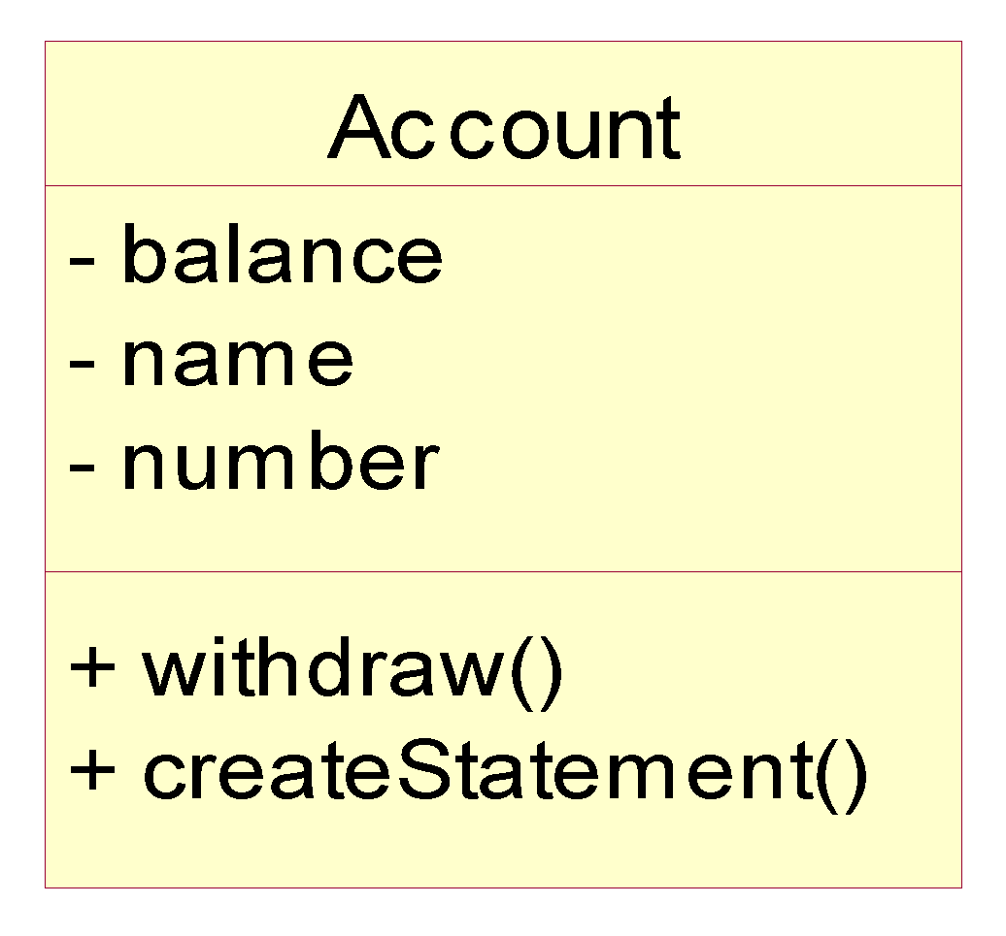
Example: Single Inheritance
One class inherits from another.
Ancestor
Superclass (parent)
Inheritance Relationship
Savings
Checking
Subclasses
Descendents
Notes:
The generalization is drawn from the subclass class to the superclass/parent class.
The terms “ancestor” and “descendent” may be used instead of “superclass” and “subclass.”

Slide 52
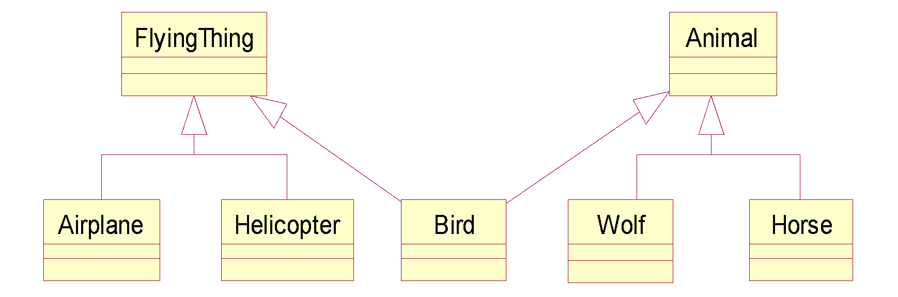
Example: Multiple Inheritance
A class can inherit from several other classes.
Multiple Inheritance
Use multiple inheritance only when needed and
always with caution!
Notes:
Multiple inheritance means that a class can inherit from several other classes. For example, Bird inherits from both FlyingThing and Animal.
Multiple inheritance is conceptually straight forward and may be needed to model the real world accurately. However, there are potential implementation problems when you use multiple inheritance, and not all implementation languages support it. Thus, be judicious with your use of multiple inheritance. Use it only where it accurately describes the concept you are trying to model and reduces the complexity of your model. Be aware, however, that this representation will probably need to be adjusted in design and implementation.
Generally, a class inherits from only one class.
Some languages do not support multiple inheritance.

Slide 53
Polymorphism
Polymorphism—the same word or phrase can be mean different things in different contexts
Analogy: in English, bank can mean side of a river or a place to put money
In Java, two or more classes could each have a method called output
Each output method would do the right thing for the class that it was in.
One output might display a number whereas a different one might display a name.

Slide 54
What Is Polymorphism?
The ability to hide many different implementation behind a single interface.
Manufacturer B
Manufacturer A
Manufacturer C
OO Principle: Encapsulation
Notes:
The Greek term polymorphos means “having many forms.” Every implementation of the interface must implement at the very least the interface. In some cases, the implementation can implement more than the interface.
For example, the same remote can be used to control any type of television that supports a specific interface (the interface the remote was designed to be used with).

Slide 55
Example: Polymorphism
Get Current Value
getCurrentValue()
getCurrentValue()
getCurrentValue()
Stock
Bond
Mutual Fund
Notes:
In this example, a requesting object would like to know the current value of a financial instrument. However, the current value for each financial instrument is calculated in a different fashion. The stock needs to determine the current asking price in the financial market that it is listed under. The bond needs to determine the time to maturity and interest rates. A mutual fund needs to look up the closing price from the day from the fund management company.
In a non object-oriented development environment, we would write code that may look something like this:
IF financialInstrument = Stock THEN
calcStockValue()
IF financialInstrument = Bond THEN
calcBondValue()
IF financialInstrument = MutualFund THEN
calcMutualFundValue()
With object technology, each financial instrument can be represented by a class, and each class would know how to calculate its own value. The requesting object simply needs to ask the specific object (for example, Stock) to get its current value. The requesting object does not need to keep track of three different operation signatures. It only needs to know one. Polymorphism allows the same message to be handled in different ways depending on the object that receives it.
This diagram shows how three different object can have the same operation: getCurrentValue().
However, the way that each interprets that operation is unique because the current value for each instrument is dependent on different variables.
Point out that the requesting object does not need to know anything about the calculations or the differences. All it cares is that the current value is calculated.

Slide 56

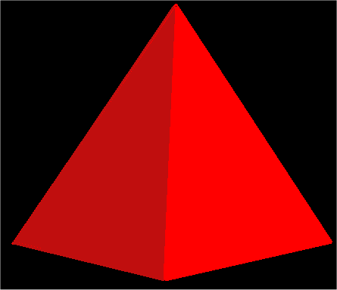
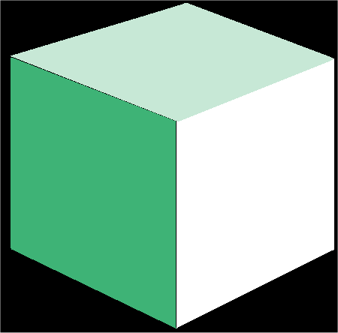
What is an Interface?
An interface is a collection of operations that specify a service of a class or component.
Interfaces formalize polymorphism
Interfaces support “plug-and-play” architectures
‘How’
Tube
<<Interface>>
Shape
‘What’
Pyramid
draw()
move()
scale()
rotate()
Cube
Realization relationship
(stay tuned for realization relationships)
Notes:
Interfaces are not abstract classes, as abstract classes allow you to provide default behavior for some/all of their methods. Interfaces provide no default behavior.
From the UML User’s Guide (Booch, 1999): An interface is “a collection of operations that are used to specify a service of a class or a component.”
Interfaces formalize polymorphism. They allow us to define polymorphism in a declarative way, unrelated to implementation. Two elements are polymorphic with respect to a set of behaviors if they realize the same interfaces. In other words, if two objects use the same behaviors to get different, but similar results, they are considered to be polymorphic. A cube and a pyramid can both be drawn, moved, scaled, and rotated, but they look very different.
You’ve probably heard that polymorphism one of the big benefits of object orientation, but without interfaces there was no way to enforce it, verify it, or even express it except in informal or language-specific ways. Formalization of interfaces strips away the mystery of polymorphism and gives us a good way to describe, in precise terms, what polymorphism is all about. Interfaces are testable, verifiable, and precise.
Interfaces are the key to the “plug-and-play” ability of an architecture: Any classifiers (e.g., classes, subsystems, components) which realize the same interfaces may be substituted for one another in the system, thereby supporting the changing of implementations without affecting clients.
Realization relationships are discussed later in this module.

Slide 57
How Do You Represent An Interface?
Elided/Iconic Representation (“lollipop”)
Tube
Pyramid
Shape
Cube
Canonical (Class/Stereotype) Representation
Tube
<<Interface>>
Shape
Pyramid
draw()
move()
scale()
rotate()
Cube
(stay tuned for realization relationships)
Notes:
The lollipop notation is best used when you only need to denote the existence of an interface. If you need to see the details of the interface (e.g., the operations), then the class/stereotype representation is more appropriate.
From The Random House Collegiate Dictionary:
Elide: “to pass over; omit; ignore.”
Canonical: “authorized; recognized; accepted.”
According to the “UML User Guide” there are two ways to represent a realizes relationship with an interface. The Elided form (“Lollipop”) is useful when you want to expose the seams of the system, however, there is a limitation in that you can’t visualize the operations on the interface.
The second way, canonical, allows you to visualize the operations on the interface.

Slide 58
What is an Abstract Class?
An abstract class is a class that may not has any direct instances.
In the UML, you specify that a class is abstract by writing its name in italics.
An abstract operation is an operation that it is incomplete and requires a child to supply an implementation of the operation.
In the UML, you specify an abstract operation by writing its name in italics.
Shape
{abstract}
Abstract class
draw () {abstract}
Abstract operation
Circle
Rectangle
draw ()
draw ()
Notes:
In the Best Practices module, we discussed some characteristics common to successful projects. OO facilitates the following best practices:
Develop Iteratively
Model Visually
Use Component Architecture
Defining basic OO terms and concepts allows everyone in the class to start on a level playing field.

Slide 59
Inheritance
The advantage of making a new class a subclass is that it will
inherit attributes and methods of its parent class (also called
the superclass).
Subclasses extend existing classes in three ways:
By defining new (additional) attributes and methods.
By overriding (changing the behavior) existing attributes and methods.
By hiding existing attributes and methods.

Slide 60
Subclasses
When a new class is developed a programmer can define it to
be a subclass of an existing class.
Subclasses are used to define special cases, extensions, or other variations from the originally defined class.
Examples:
Terrier can be defined as a subclass of Dog.
SavingsAccount and CheckingAccount can be derived from the Account class (see following slides).
Generic Class for Dog
With general attributes and behaviors for all dogs.
Terrier is derived
from Dog
Specific Class for Terrier
With new attributes and behaviors specific to the Terrier breed.
Notes:
Note: Derived from implies superclass-subclass relationship, i.e. SavingsAccount would be a subclass of Account.
Examples:
Terrier can be defined as a subclass of Dog.
SavingsAccount and CheckingAccount can be derived from the Account class.

Slide 61
New Account Types - Cont’d
Suppose we define SavingsAccount and CheckingAccount
as two new subclasses of the Account class.
class SavingsAccount extends Account { method rate() {…} }
class Account { method acctNum() {…} method balance() {…} method deposit() {…} method withdraw() {…} }
class CheckingAccount extends Account { method withdraw() {…} }

Slide 62
New Account Types - Cont’d
Account
SavingsAccount
CheckingAccount
acctNum()
acctNum()
acctNum()
balance()
balance()
balance()
deposit()
deposit()
deposit()
withdraw()
withdraw()
withdraw()
rate()
withdraw()
No new code has to be written for deposit() and other methods, they are inherited from the superclass.
Notes:
Note: The new version of withdraw() in the CheckingAccount OVERRIDES the method of withdraw() in Account.

Slide 63
Messages
Messages are information/requests that objects send to other objects (or to themselves).
Message components include:
The name of the object to receive the message.
The name of the method to perform.
Any parameters needed for the method.
Manager
Employee
Message To: Employee Method: getHired Parameters: salary = $45,000, start_date = 10/21/99

Slide 64
Benefits of Messages
Message passing supports all possible interactions between
two objects.
Message passing is the mechanism that is used to invoke a method of the object.
Objects do not need to be part of the same process or on the same machine to interact with one another.
Message passing is a run-time behavior, thus it is not the same as a procedure call in other languages (compile-time).
The address of the method is determined dynamically at run-time, as the true type of the object may not be known to the compiler.

Slide 65
Polymorphism
Polymorphism is one of the essential features of an object-
oriented language; this is the mechanism of decoupling the
behavior from the message.
The same message sent to different types of objects results in:
execution of behavior that is specific to the object and,
possibly different behavior than that of other objects receiving the same message.
Example: the message draw() sent to an object of type Square and an object of type Circle will result in different behaviors for each object.

Slide 66
Polymorphism – Cont’d
There are many forms of Polymorphism in object-oriented
languages, such as:
True Polymorphism: Same method signature defined for different classes with different behaviors (i.e. draw() for the Classes Circle and Square)
Parametric Polymorphism: This is the use of the same method name within a class, but with a different signature (different parameters).
Overloading: This usually refers to operators (such as +,-,/,*, etc) when they can be applied to several types such as int, floats, strings, etc.
Overriding: This refers to the feature of subclasses that replace the behavior of a parent class with new or modified behavior.

Slide 67
OO Concepts Summary
Object-oriented programming is a way of conceptualizing a program as groups of objects that interact with one another.
A class is a general template used to create objects.
The combination of collecting all the attributes of an object into a single class definition, combined with the ability to hide some definitions within the class, is known as encapsulation.
Classes can also define class variables and class methods which are attributes and methods associated with the class as a whole.
Inheritance allows classes to “inherit” attributes and methods from their base (parent) class. This provides a clean mechanism for code re-use and extension.

Slide 68
Software Development Lifecycles
Software lifecycles describe the evolution of a software
project from conception of the need for a software system to
the retirement or replacement of the resulting system.
Two key dimensions of a specific lifecycle are:
The collection of activities to be done
The flow or sequencing of those activities

Slide 69
Common Lifecycle Activities
Project Charter (definition): General description or problem statement, top level business scenarios.
Analysis: Systems level, low detail, problem space oriented. Results in Requirements/Specification document.
Design: Implementation level, high detail, solution space oriented. Results in Software design/model document.
Implementation: Coding, testing, UI, data design, documentation. Results in deliverable product.
Delivery: Configuration, training, maintenance, product evolution planning.
Product end of life planning: Replacement

Slide 70
Common Lifecycle Flows
Lifecycle flows (there are just about as many of these as there
are software projects…) can generally be characterized as one
of the following types:
Sequential
Waterfall method, Structured Analysis & Design
Iterative, Spiral and Recursive Methods
There are a huge variety of these
“Agile” or “LightWeight” Software Methods fit into this class
Parallel Effort
Unmanaged, Chaotic

Slide 71
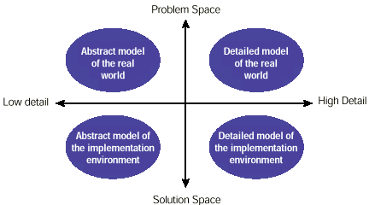
Analysis and Design Space

Slide 72
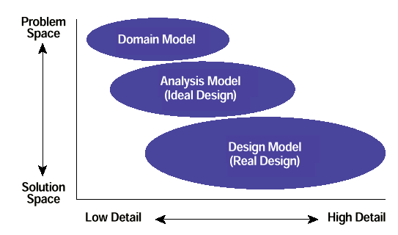
Analysis and Design Space - Cont’d

Slide 73
Outline
Key Object-Oriented Systems Concepts
Basic Software Lifecycle Concepts
Introduction to OOA/OOD
Scenarios and Use Cases
CRC’s
Sequence Diagrams
Class Diagrams
UML Models

Slide 74
Use Cases
Use cases describe the basic business logic of an application.
Use cases typically written in structured English or Diagrams
Represent potential business situations of an application
Describes a way in which a real-world actor – a person, organization, or external system – interacts with the application.
For example, the following would be considered use cases for a
university information system:
Enroll students in courses
Output seminar enrolment lists
Remove students from courses
Produce student transcripts.

Slide 75
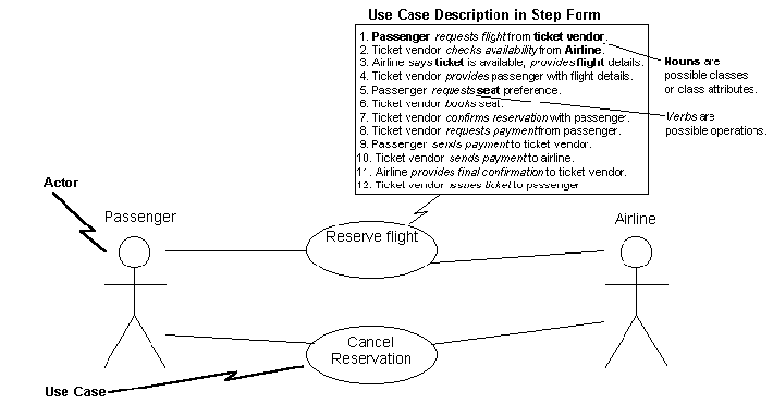
Use Cases Diagrams

Slide 76
Class Responsibility Collaborator Cards
A CRC model is a collection of CRC cards that represent whole or part of an application or problem domain
The most common use for CRC models is to gather and define the user requirements for an object-oriented application
The next slide presents an example CRC model for a shipping/inventory control system, showing the CRC cards as they would be placed
Note the placement of the cards: Cards that collaborate with one another are close to each other, cards that don’t collaborate are not near each other

Slide 77
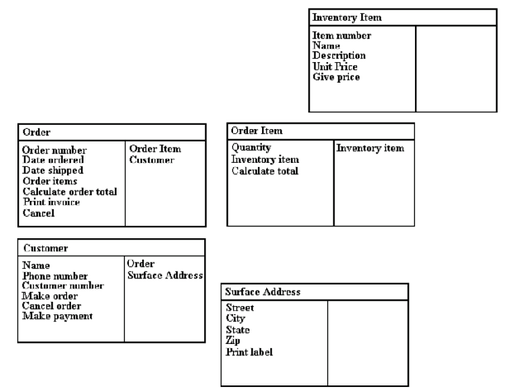
CRC Example
Class Information
Methods and Attributes
Collaborators

Slide 78
CRC Card Layout
Class Name:
Parent Class:
Subclasses:
Attributes:
Collaborators (Sends Messages to):
Responsibilities:

Slide 79
Sequence Diagrams
Traditional sequence diagrams show:
The objects involved in the use case
The messages that they send each other
Return values associated with the messages
Sequence diagrams are a great way to review your work as
they force you to walk through the logic to fulfill a use-case
scenario and match the responsibilities and collaborators in
CRC cards.

Slide 80
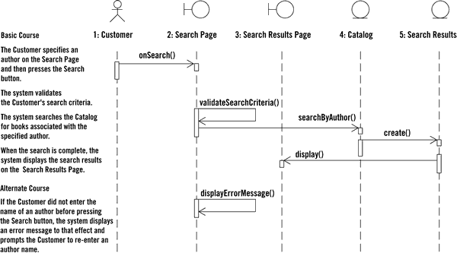
Sequence Diagrams

Slide 81
Class Diagrams
Class diagrams (object models) are the mainstay
of OO modeling
They are used to show both what the system will be able to do (analysis) and how it will be built (design)
Class diagrams show the classes of the system and their interrelationships
Inheritance
Aggregation
Associations

Slide 82
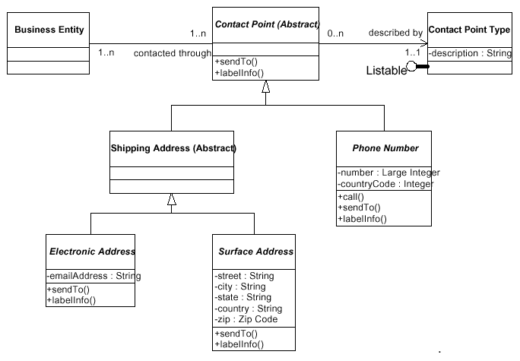
Class Diagram

Slide 83
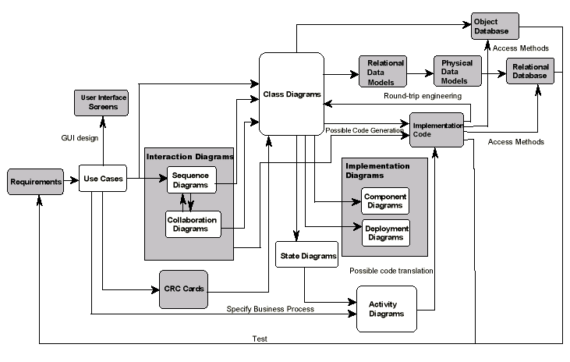
UML Models

Slide 84

Review: Introduction to Object Orientation
What are the four basic principles of object orientation? Provide a brief description of each.
What is an Object and what is a Class? What is the difference between them?
What is an Attribute?
What is an Operation?
What is inheritance?
What is polymorphism?
Describe the strengths of object orientation.
OOAD process
Groupt work Research and summarrize on methods/tools of analysis and design of OO programs 10 mins presentation next week

Slide 85
Review: Introduction to Object Orientation
State 2 differences between functional programming and OOP.
What are the four basic principles of object orientation? Provide a brief description of each.
What is an Object and what is a Class? What is the difference between them?
What is an Attribute?
What is an Operation?
Describe the strengths of object orientation.

